Slide 1
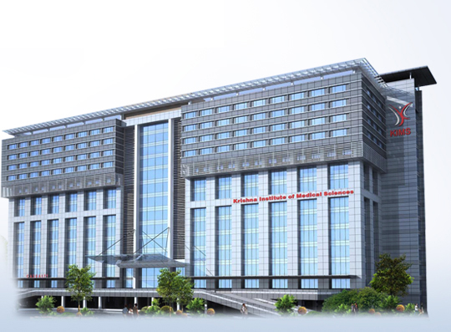
MITRAL REGURGITATION FROM BEDSIDE TO HEMODYNAMICS
Dr. DayaSagar Rao. V
DM(Cardiology) FRCP(Canada) FRCP(Edinburgh)
Senior Consultant Interventional Cardiologist – KIMS Secundrabad

Slide 2
MITRAL REGURGITATION
Regurgitation – LV to LA:
Severity is expressed
Regurgitant volume
Regurgitant fraction (%)
Decrease effective forward flow

Slide 3
Valvular regurgitation
NATIVE VALVE
Primary :
Chronic
Acute
Acute on chronic
Secondary
Functional
Prosthetic valve

Slide 4
RgV = RoA x C_{d} x √MPG x T
(Levine and Gaasch JACC:1996, 28: 1083-91)
ROA = Regurgitant orifice area
- Fundamental determinant – directly proportional
- Dynamic : Size & Shape
- Load Dependent

Slide 5
Discharge Co-efficient
Cd = Discharge Co-efficient. Geometric area – Effective orifice area smaller by 15-20% (0.8 – 0.85 of geometric area)
Orifice geometry
Flow
Viscosity

Slide 7
Systolic MPG
LV-LA Pressure gradient
Important determinant RV
MPG on RV
function of its square root
25% reduction MPG – results 13% reduction RV
SBP at time of assessment should be considered
With HTN
Intraop evaluation of MR on CPB with low SBP
Therapeutic
Decrease SBP
Decrease RV

Slide 8
Duration: Systole - MR
Patients MVPS
Late MR
Single frame measurement
jet area Vena Contracta PISA
Over estimation severity MR
Analysis – Doppler-cw: onset-offset

Slide 9
There is no mitral regurgitation (MR) in early (A) or mid (B) systole. In late systole, a large MR jet with a large proximal flow convergence region (black arrow) and wide vena contracta is seen (C). Continuous-wave Doppler of the same MR jet shows that it is present only during late systole (D). In such cases, a single-frame measurement, such as proximal isovelocity surface area or vena contracta, overestimates MR severity.

Slide 10
Mitral Regurgitation causes
PRIMARY - CRHD
- MVPS
- Connective Tissue
- Infective Endocarditis
Congenital - Part AV canal
- Isolated cleft
Drug induced - Anorectic
- Antiparkinsonian
- Radiation injury
Interventional

Slide 16
PARAMETERS
Symptoms/ History
Physical signs: -JVP
-Pulse
-BP
Chamber enlargement
Cardiac murmurs
Dynamic auscultation

Slide 17
PHYSICAL SIGNS
Influenced by : - Heart rate
- Blood pressure
- Cardiac output
- Heart failure
Volume & volume of Blood flow – Cardiac murmurs
Low output – Alters the murmurs (intensity & duration)

Slide 18
SYMPTOMS
- Filling pressures: (LA/RA)
- Cardiac output : Low output
Extent of disability: Self care Activity : 3 Mets
Household Activity
Leisure Activity
Sport Activity : 10 Mets
More symptomatic - More severe lesion
Discrepancy - Symptoms & Severity
- Co- Morbidities : Anemia
Infections
Thyroid Etc.

Slide 19
COMPLICATIONS
- Cardiomegaly
- CHF / Ventricular Dysfunction
- PAH
- Atrial Fibrillation/Dysrhythmias
Related – Severity & Duration of valvular Disease

Slide 20
MITRAL REGURGITATION
Cardiomegaly / LV apex / PH
Auscultatory findings - severity MR & valve morphology
Wide splitting II, Early closure of A2
S3
PSM – Grade IV Conducted Axilla & Interscapular region
MDM
+

Slide 21
Murmur is harsh (instead of soft blowing) indicating low & medium frequency.
usually indicates lot of flow & thus significant regurgitation
Variable correlation between intensity of MR murmur & severity of regurgitation.
Loud murmur associated with thrill (grade IV / greater)
Specificity : 91% Severe MR
Sensitivity : 24%

Slide 22
CLINICAL ASSESSMENT OF VALVULAR HEART DISEASE
Symptom evaluation : severity
Complications – AF,PH, CHF
Cardiomegaly – chamber enlargement
Sounds :S1&S2
S4/S3
Cardiac murmurs: - length of murmur
- Intensity
- Conduction

Slide 23
ECHO Doppler evaluation-Regurgitation- valvular
M-mode – temporal resolution
2DE: TTE Multiple views
TOE
Pulse Doppler/CW Doppler -Flows/VTI
Colour Doppler - Qualitative jet parameters
- Quantitative - Vena Contracta
- PISA(for EROA)
Tissue Doppler - for LV function
Stress Echo : - Physical
- Pharmacologic
RT3DE

Slide 24
ECHO Doppler: valvular regurgitation
Anatomy : Valve
Size of LV
Aorta
Function:
Complications:

Slide 25
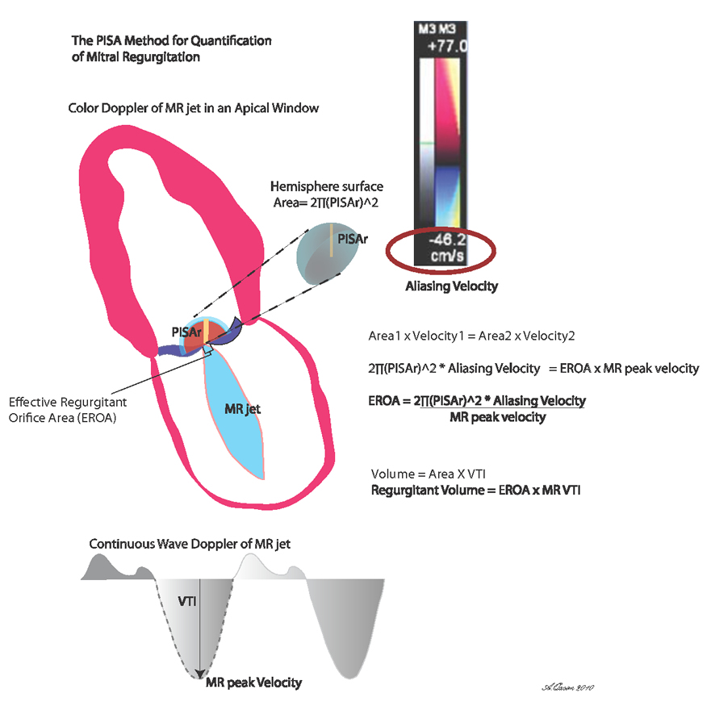

Slide 26
ECHO-Doppler Grading
Severity | MR | Primary
Qualitative
MR Jet | Length | 1/2 Length LA
 | Area | <4cm² - >10cm²
 | Area/LA area | <20% - > 40%
Semi Quantitative
VC width (mm) | <3 | >7mm
VTI: Mitral/Aorta | <1 | >1.4
Mitral Flow | A>E | E>1.5cm/sec
Pulm Vein Flow | Systolic Dominance | Systolic flow reversal
Quantitative
EROA (mm²) | <20 | >40
Reg Volume | <30 | >60
LA/LV Size/PA pressure
European Association Imaging - 2013

Slide 29
Mitral Regurgitation Index
Six parameters : Jet length
PISA
Jet Density
Pulm venous flow pattern
PA pressure (RVSP)
LA Size
Each Parameter Grade: 0-3/6
MR index: <1.6 >2.1

Slide 30
ECHO Doppler Grading
Severity | AR
Qualitative
Colour flow jet | Width Length
Diastolic Flow reversal (Desc Thor Aorta) Abd Aorta | Pan diastolic
Semi Quantitative
VC (width) | <3mm >6mm
PHT (msec) | >500 <200
Quantitative
EROA (mm²) | <10 >30
Reg Volume (ml) | <30 >60
LV Size/Function

Slide 31
MR - Severity
Stress Testing
- Physical stress
- Pharmacological
Exercising capacity
Symptoms
Response PA Pressure (PA > 60 mmHg)
LV function: response to stress – EF: %
- contractile reserve
- Tissue doppler parameters
- Strain: long axis
- Global

Slide 32
CMR (cine MRI)
Volumes – calculated : short axis slices
Stroke volume: Phase contrast velocity encoding
(distal sinotubular ridge)
Contraindications
Arrhythmias: ECG gating
- AF in MV disease
Medical devices – Pacemakers
- CRT
- ICD
Availability – Ecpertise – interpretation
- Cost
Claustrophobia

Slide 33
CMR (cine MRI)
Volumes – calculated : short axis slices
Stroke volume: Phase contrast velocity encoding
(distal sinotubular ridge)
Contraindications
Arrhythmias: ECG gating
- AF in MV disease
Medical devices – Pacemakers
- CRT
- ICD
Availability – Ecpertise – interpretation
- Cost
Claustrophobia

Slide 34
Cath lab – Evaluation -Severity regurgitation
Cardiac cath
- Symptomatic patient
Non invasive tests – inconclusive
Discrepancy Non invasive test & physical exam
(Severity of lesion)
-Asymptomatic
Exercise testing
- confirm absence of symptoms
- Assess Hemodynamic response to exercise
- prognosis
ACC/AHA Guidelines – 2014
Management of patients Valvular heart Disease

Slide 35
Angiographic Assessment of Severity by Left Ventriculography
 | LA opacification | Time required | Clearance of LA opacification | Comparison with opacification of LV
1+ (Mild) | Partial (Never complete) | ----- | Single beat | Less
2+ (Moderate) | Faint complete | Several beats | Several beats | Less
3+ (moderately severe) | Complete | Several beats | Several beats | Same
4+ (severe) | Complete | Single beat | Several beats | More dense with each beat Reflux of contrast in pulmonary veins

Slide 36
Valvular Regurgitation Severity Assessment
Clinical
2DEcho + Doppler
Qualitative
Quantitative
Cath lab
Obsolete for many
Physical exam
ECG
CxR-PA
Data

